Slide 1

Business Intelligence Report
Revenue Growth &
Performance Intelligence
Dashboard
Turning Sales & Operational Data into Strategic Revenue Decisions
Prepared by
Power BI
DAX
Star Schema
Meghana M
March 2026

Slide 2
Foundation
Dataset Overview
Multi-Dimensional E-Commerce Environment
Operational Metrics
The dataset represents a comprehensive e-commerce sales environment containing ~100,000 orders across multiple states, integrating financial, operational, and customer experience metrics for holistic business intelligence.
Delivery timelines & duration tracking
Order-to-delivery performance
Customer Experience
Financial Metrics
Geographic Data
Review score ratings
Revenue tracking
Customer state locations
Review category classification
Order value analysis
Seller state distribution
Freight cost data
Regional performance
Data Constraints
•
No direct profit column
Product Data
Seller Performance
•
No marketing spend data
Category classification
Seller ID mapping
•
No customer lifetime tracking
Product ID tracking
Revenue contribution
•
No detailed cancellation codes
SKU-level details
Performance metrics

Slide 3
Transformation Pipeline
Data Preparation Process
01
Data Cleaning
02
Feature Engineering
03
Data Modeling
Power Query Editor
DAX Calculated Measures
Star Schema Architecture
✓
Removed duplicate records
→
Total Revenue & Total Orders
Fact Table
✓
Standardized date formats
→
Average Order Value (AOV)
Orders/Sales Fact
✓
Validated state & category naming
→
YoY Revenue Growth %
Revenue, Freight, Delivery Days, Review
✓
Created delivery duration metric
→
Positive Review %
Dimension Tables
✓
Categorized review scores
→
Freight-to-Revenue Ratio
Date, Customer State, Seller, Product, Category
→
Cumulative Seller Revenue %
Transformation Impact
99K
8+
5
<2s
Clean Orders
KPI Measures
Dimension Tables
Query Response

Slide 4
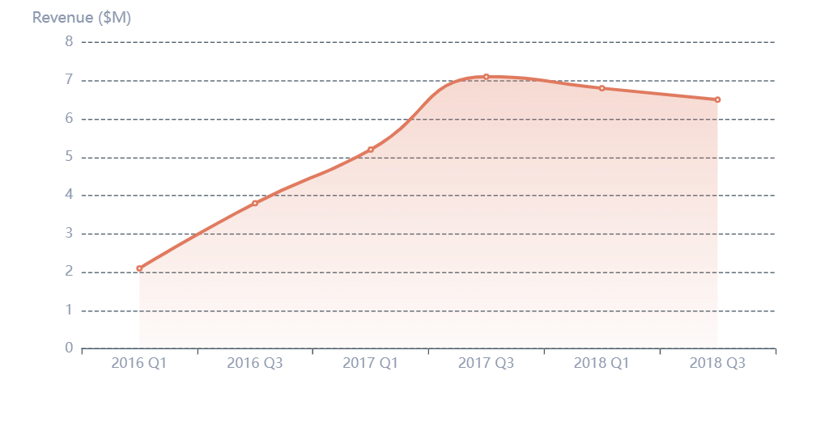
Performance Analysis
Executive Revenue Overview
Total Revenue
Total Orders
Average Order Value
YoY Growth
$13.59M
99K
$136.68
2.05%
Across all orders
Processed orders
Per transaction
Year-over-year
Revenue Trend Over Time
Top Revenue States
SP
35%
RJ
28%
MG
18%
Top Categories
health_and_beauty
watches_and_gifts
bed_bath_table
Key Insight
Growth is stable but not accelerating — strategic expansion and operational improvements are required.

Slide 5
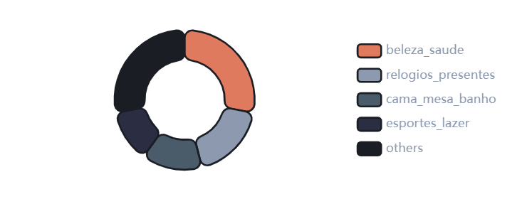
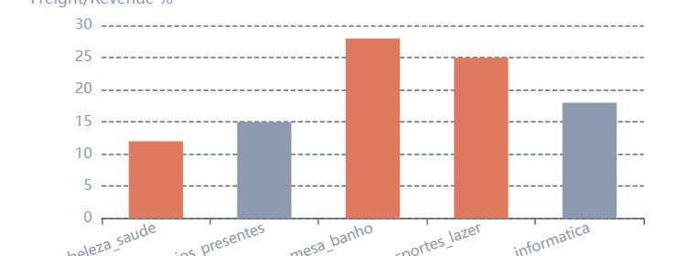
Revenue Drivers
Product & Category Intelligence
Category Revenue Distribution
Freight Impact Analysis
Dependency Risk
Margin Pressure
Growth Trends
Top 3 categories contribute ~60% of total revenue.
Categories like cama_mesa_banho show high freight ratios.
Significant spikes observed mid-2017 ; later growth stabilizes.
High concentration risk identified
Reducing margin efficiency
Market maturation signals
Business Insight
Revenue concentration combined with high freight categories may impact long-term profitability. Diversification and logistics optimization required.

Slide 6
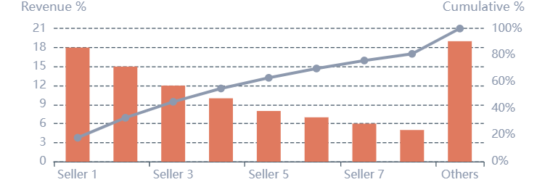
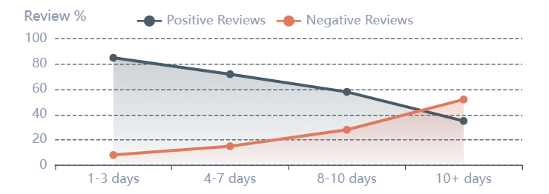
Performance Metrics
Seller & Operational Performance
Revenue Concentration (Pareto Analysis)
Delivery Speed vs Review Sentiment
Top Seller Dependency
State Satisfaction Variations
Delivery-Review Correlation
Top 5-10 sellers generate majority of revenue following Pareto distribution.
Some states (e.g., RJ ) show higher negative review ratios.
Fast deliveries → Higher positive reviews
Slow deliveries (10+ days) → Surge in negative reviews
Risk:
High dependency on few sellers
Action:
Regional operational review needed
Business Insight
Delivery performance directly impacts customer satisfaction and potentially revenue sustainability. Operational excellence in logistics is critical for long-term success.

Slide 7
Diagnostic Analysis
Root Cause & Revenue Driver Analysis
Decomposition Analysis Framework
Critical Finding: Delivery Impact
Revenue Performance
Slow Deliveries (10+ days)
Broken down by seller state, delivery speed, review category
Strongly linked to operational inefficiencies and customer dissatisfaction
Review Performance
52%
High
RJ/MG
Analyzed across delivery timelines and geographic regions
Negative Reviews
Revenue Leakage
Concentration
Correlation Mapping
Root Cause Identified
Identifying relationships between operational metrics
Operational delays are the primary root cause of satisfaction decline and revenue risk.
Geographic Factor
Operational Factor
Experience Factor
Financial Factor
State Concentration
Delivery Speed
Review Category
Revenue Impact

Slide 8
Strategic Findings
Key Business Insights
01
Geographic Revenue Concentration
04
Delivery-Satisfaction Correlation
Revenue is heavily concentrated in SP, RJ, and MG states, indicating regional market dominance but also concentration risk.
Slow delivery (10+ days) significantly increases negative reviews, directly impacting customer satisfaction.
02
Category Dependency Risk
05
Freight Cost Impact
Top 3 categories contribute ~60% of total revenue, creating high dependency risk that requires diversification.
High freight categories reduce margin efficiency, requiring pricing strategy adjustments or logistics optimization.
03
Seller Concentration (Pareto)
06
Growth Stabilization
Revenue heavily depends on top sellers following Pareto distribution, requiring seller diversification strategy.
Growth after 2017 shows signs of stabilization, not acceleration , signaling potential market saturation or operational bottlenecks.
Executive Summary
The analysis reveals a business with strong revenue foundations but significant concentration risks across geography, categories, and sellers. Operational efficiency, particularly in delivery performance, emerges as a critical lever for customer satisfaction and sustainable growth.

Slide 9
Strategic Actions
Actionable Recommendations
01
Reduce Slow Deliveries
03
Diversify Revenue Base
05
Expand High-Growth Categories
Prioritize logistics optimization in states with high delay rates. Implement route optimization and carrier performance monitoring.
Promote mid-tier sellers to reduce dependency on top 5 sellers. Implement seller development programs.
Scale SKUs in stable-growth categories like beleza_saude to capture market opportunities.
Impact:
↑ Customer Satisfaction
Impact:
↓ Concentration Risk
Impact:
↑ Market Share
02
Optimize Freight Costs
04
Target High-Performing States
06
Implement Alert System
For heavy categories, negotiate better logistics rates or adjust pricing strategy to maintain margin efficiency.
Increase marketing investment in SP and MG to maximize ROI and capitalize on proven market demand.
Monitor spikes in negative reviews by state in real-time to enable proactive issue resolution.
Impact:
↑ Margin Efficiency
Impact:
↑ Revenue Growth
Impact:
↑ Operational Agility

Slide 10
Project Outcomes
Conclusion & Dashboard Impact
Transforming Data into Strategic Intelligence
The Revenue Growth and Sales Performance Intelligence Dashboard transforms multi-dimensional sales and operational data into a structured executive decision-support system, enabling data-driven revenue growth strategies.
Project Demonstrates
Dashboard Identifies
Advanced Data Modeling
Strategic KPI Development
Revenue Vulnerabilities
Star Schema architecture for optimal performance
DAX-powered executive metrics
Geographic & category concentration risks
Operational Inefficiencies
Delivery performance gaps
Root Cause Diagnostics
Risk Identification
Operational inefficiency identification
Revenue concentration analysis
Margin Pressure Areas
High freight cost categories
Business-Aligned Storytelling
Executive-ready dashboard narratives
Growth Opportunities
Expansion & diversification paths
Multi-Stakeholder Solution
5
8+
Designed for executive, operational, and strategic stakeholders — providing actionable insights at every level of decision-making.
Dashboard Pages
KPI Measures

Slide 11

Thank You
Questions & Discussion
Date
Location
March 2026
Bangalore
Power BI
DAX
Star Schema

